Slide 1
HOW TO USE MATRIX FACTORIZATION IN RECOMMENDATION ENGINE?
Notes:
一篇著名论文的解读：Deep Matrix factorization Models for Recommender System
https://zhuanlan.zhihu.com/p/32127194
简单的具体步骤：https://www.cnblogs.com/hello-world-n/p/7784542.html
Matlab实例：https://www.cnblogs.com/moranBlogs/p/3795392.html
Python实例（全是Code）：https://blog.csdn.net/u012111465/article/details/80306252
一篇解释得比较清楚的Python实例：http://tecdat.cn/python%e6%9c%ba%e5%99%a8%e5%ad%a6%e4%b9%a0%ef%bc%9a%e6%8e%a8%e8%8d%90%e7%b3%bb%e7%bb%9f%e5%ae%9e%e7%8e%b0%ef%bc%88%e4%bb%a5%e7%9f%a9%e9%98%b5%e5%88%86%e8%a7%a3%e6%9d%a5%e5%8d%8f%e5%90%8c%e8%bf%87/
Youtube video netflix example https://www.youtube.com/watch?v=ZspR5PZemcs
More Youtube videos: https://www.youtube.com/watch?v=n3RKsY2H-NE
https://www.youtube.com/watch?v=5R1xOJOFRzs

Slide 2
hello!
We are Group 5
Cathy
Michael
Xinyi
Jiayue

Slide 3
1.
Netflix Movie Recommendation
Notes:
7.50 14.08

Slide 4

1.
Netflix Movie Recommendation

Slide 5



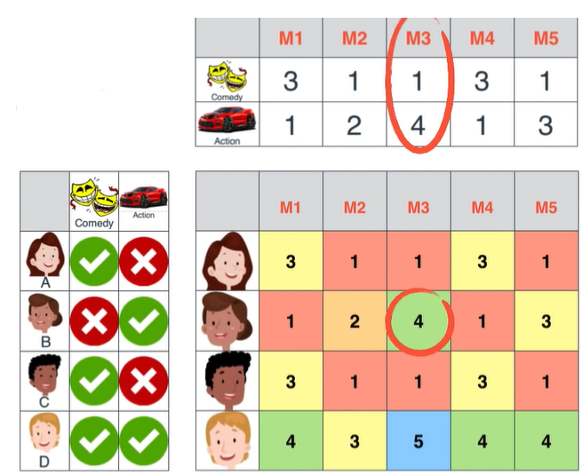
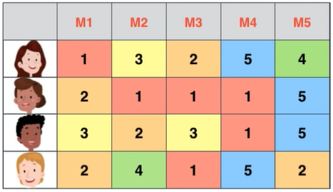
Feature:
Figure out
Dependency
Depend rows and columns
Matrix Factorization

Slide 6
2.
Benefit of Matrix Factorization in Recommending Movies

Slide 7
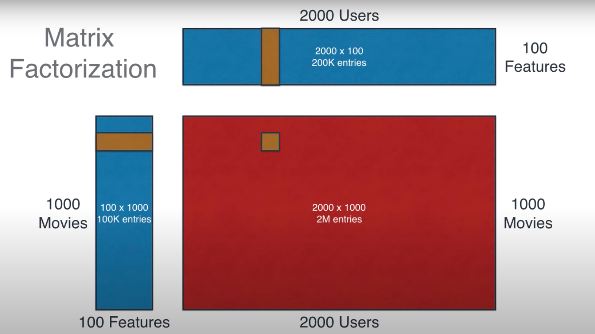
Storage
S
D
X
L
Save a lot of space
2000*1000=2000000
2000*100+100*1000=300000
2M > 300K

Slide 8
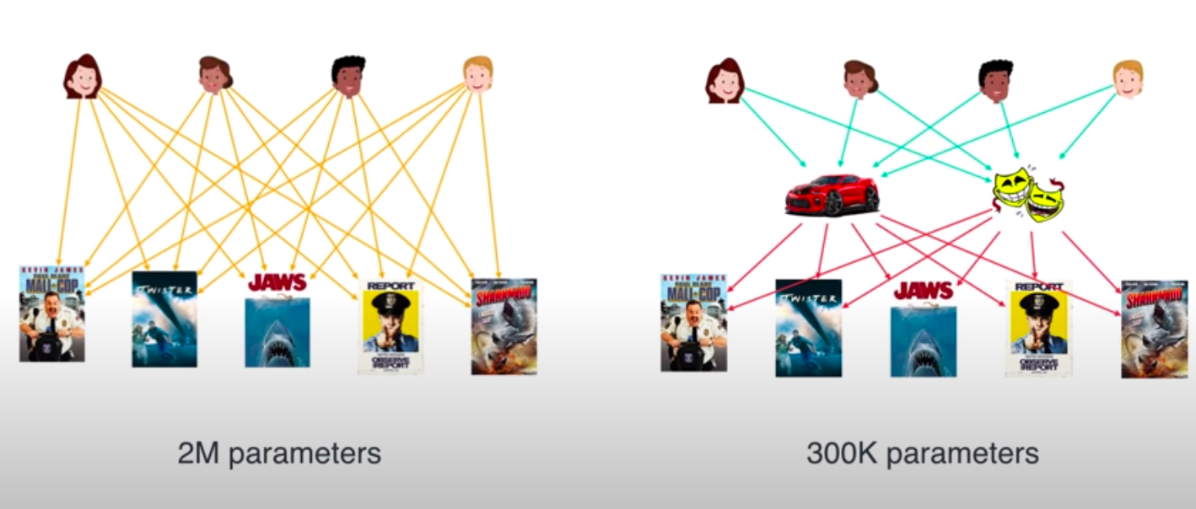

Slide 9
3.
Error function

Slide 10
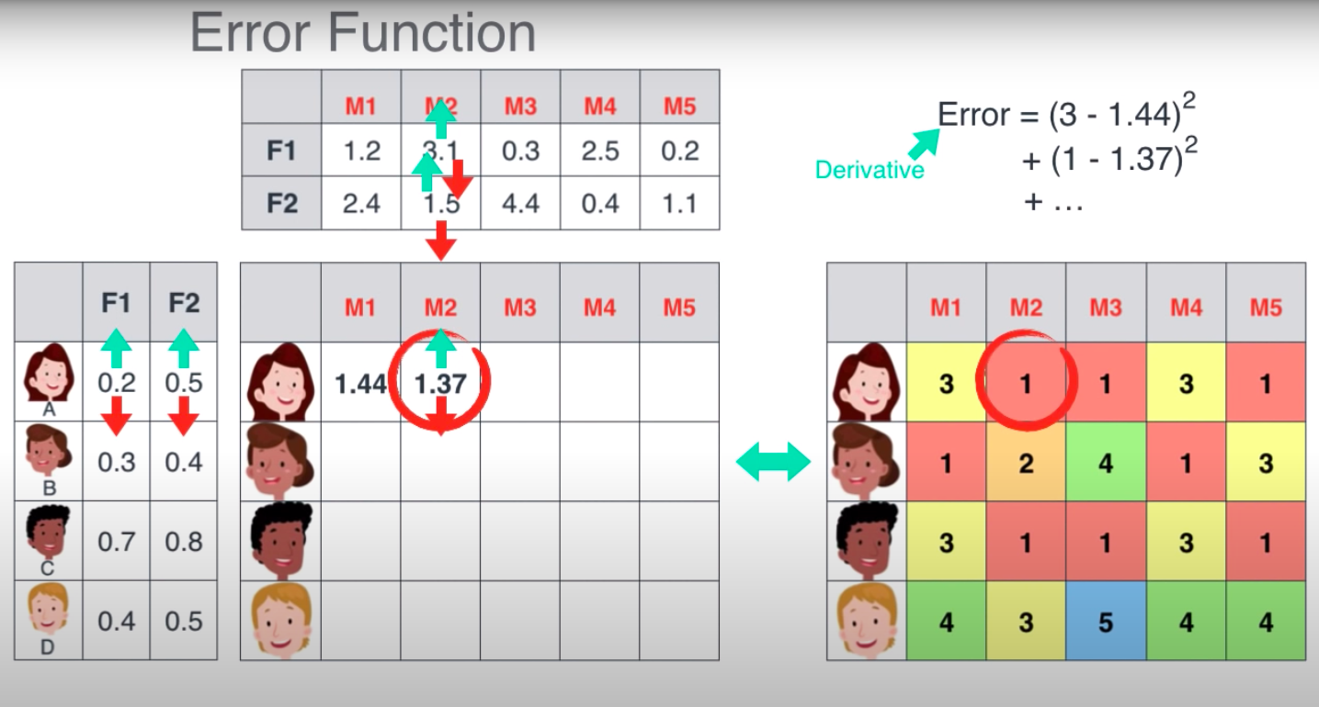
Error function is used to measure the performance of 2 factored matrices.
The objective is to decrease the sum of the squares of the differences between the factored matrices and the target matrix.
Notes:
Gradient descent
Take the derivative of the error and move towards the target

Slide 11
4.
How to Recommend?

Slide 12
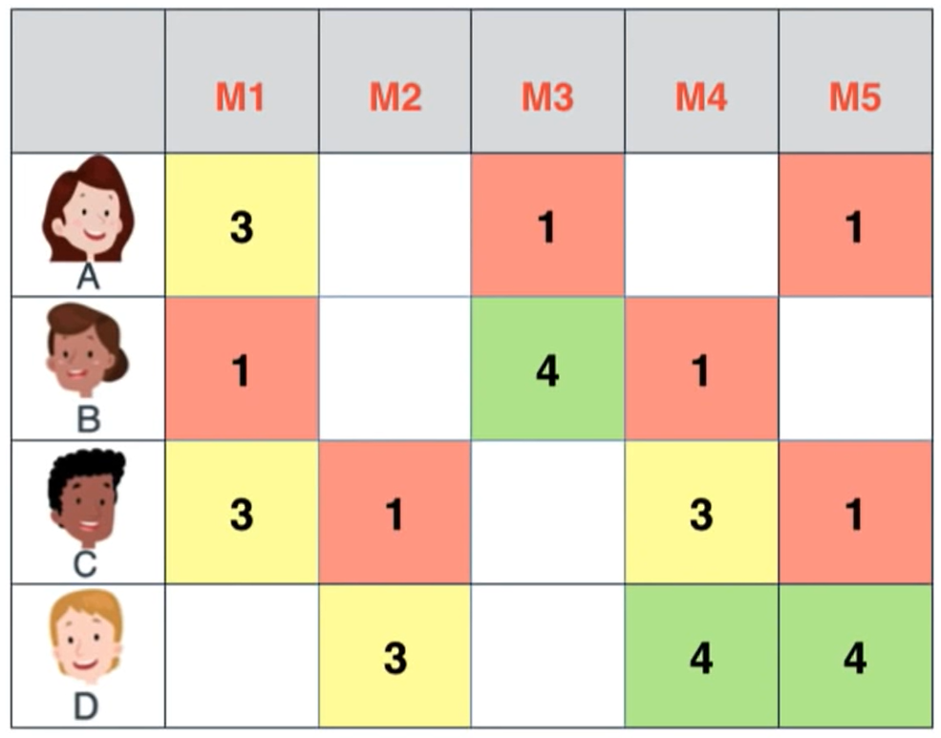
S
D
X
L
Each person will not watch all the movies. Thus, some of the review are missing. Now we can use matrix factorization to calculate the missing numbers.

Slide 13
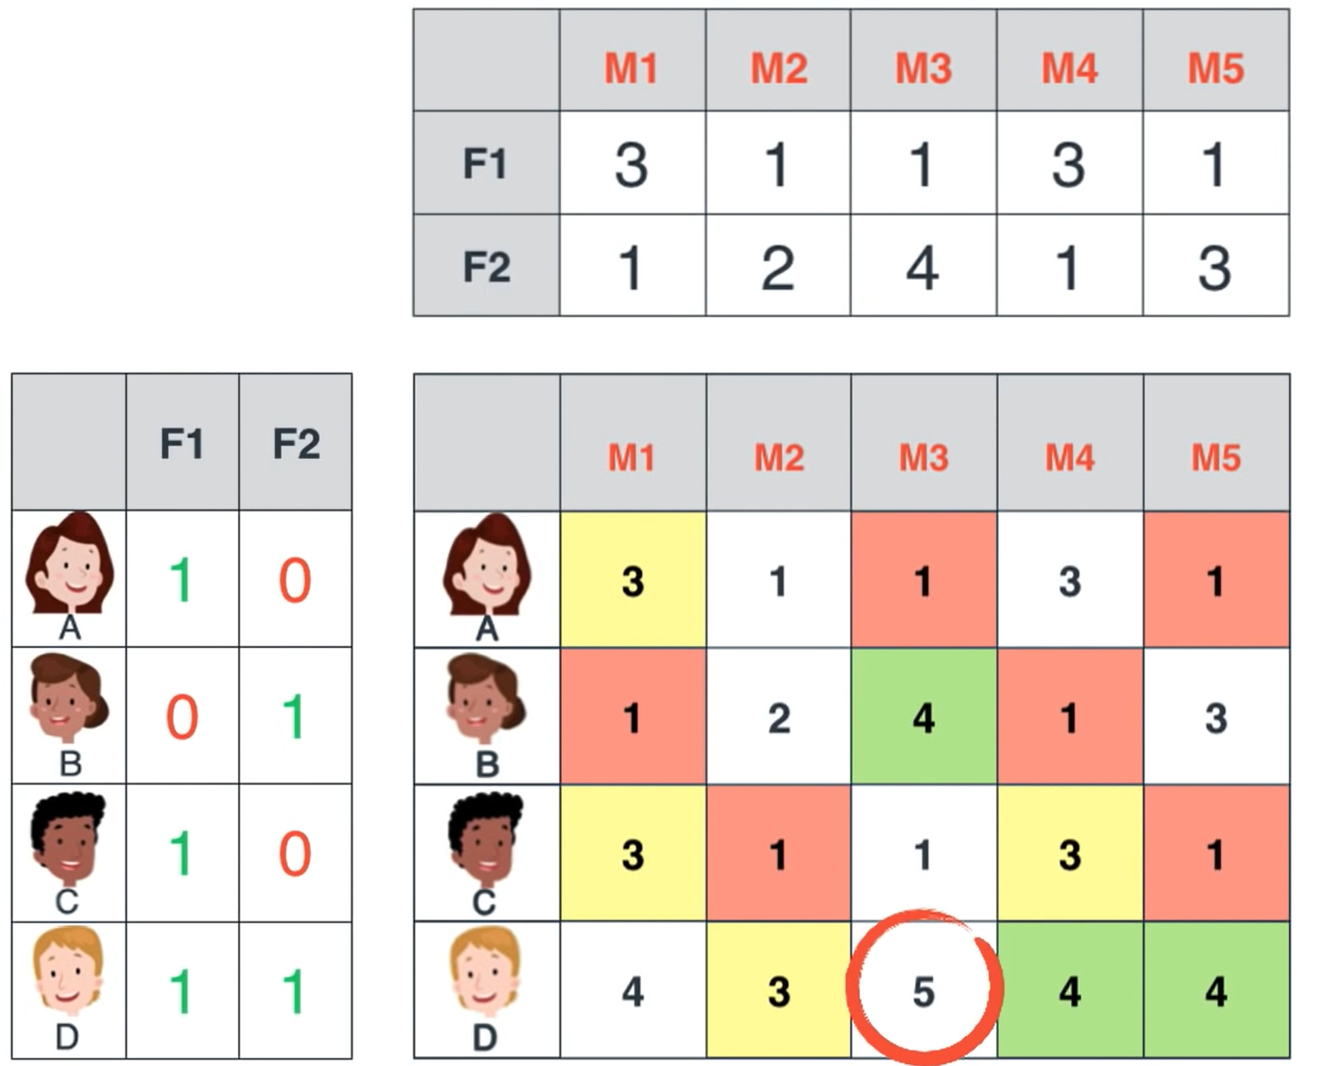
S
D
X
L
After calculation, we can see that Dana will give M3 a higher score than M1. So between M1 AND M3, Netflix should recommend M3.

Slide 14
S
D
X
L
THANK YOU!
ANY QUESTION?

